Slide 1
Space Debris Laser Ablation BY the hanbaly project
ByByt
By Ajwad Tanveer Hussain 9Q and Muhammed Jibreel Ali 9Q

Slide 2
Laser ablation
Laser ablation refers to the process of removing a certain portion of a material from the surface by high-intensity laser treatment. This is achieved by shooting a series of lasers at a solid in short increments to steadily slowing down the debris.

Slide 3
ELEctromagnets AN electromagnet can be defined as a magnet which functions on electricity. Unlike a permanent magnet, the strength of an electromagnet can be changed by changing the amount of electric current that flows through it. If the current flow is cut, the property of magnetism ceases to exist.

Slide 4
Benefits of a 3d scanner
Coverage - In just a matter of minutes, 3D scanners can collect and measure millions of data points on the surface of an object. This can help us to
Speed - 3D scanning offers a fast way to automatically collect millions of data points at the speed of light.
Accuracy – As the technology has improved, the accuracy of 3D scanning has increased over time. Currently, modern scanners provide a high degree of accuracy

Slide 5
Simulation of THE LASER WITH A TYPICAL SATELLITE.

Slide 6
10cm Debris
100km
Satellite
In this slide, we have the satellite and a space debris. The satellite
Has a laser and the space debris is made of aluminium with 10cm in diameter.
The debris is 100km away from the satellite you want them to be this faraway so the satellite is not damaged

Slide 7
10cm Debris
1. The parameters of the laser include a length of 10.6 micrometres with 100 joules of energy travelling per pulse in 10,000 metres per second.
2. This just means that it’s a short – wavelength and high energy laser that travels quite fast.

Slide 8
1. Each laser pulse lasts around 300 nano seconds and contains about five sextillion photons (a five with 21 zeros.)
Plasma pume
- 2.7 m/s
- 10 m/s
2. Each Photon has very little momentum but its enough to push the debris a little bit. When you add this up to around half a minute of pulsation which has over 1million pulses you can slow down debris enough to significantly change its orbit.
Debris
Plasma pume

Slide 9
Atmospheric re entry
Satellite
2. once the orbit reaches this point then it can fall back into the atmosphere where it burns up
1. By slowing down the debris, the lowest point of the debris orbit dips.
Earth

Slide 10
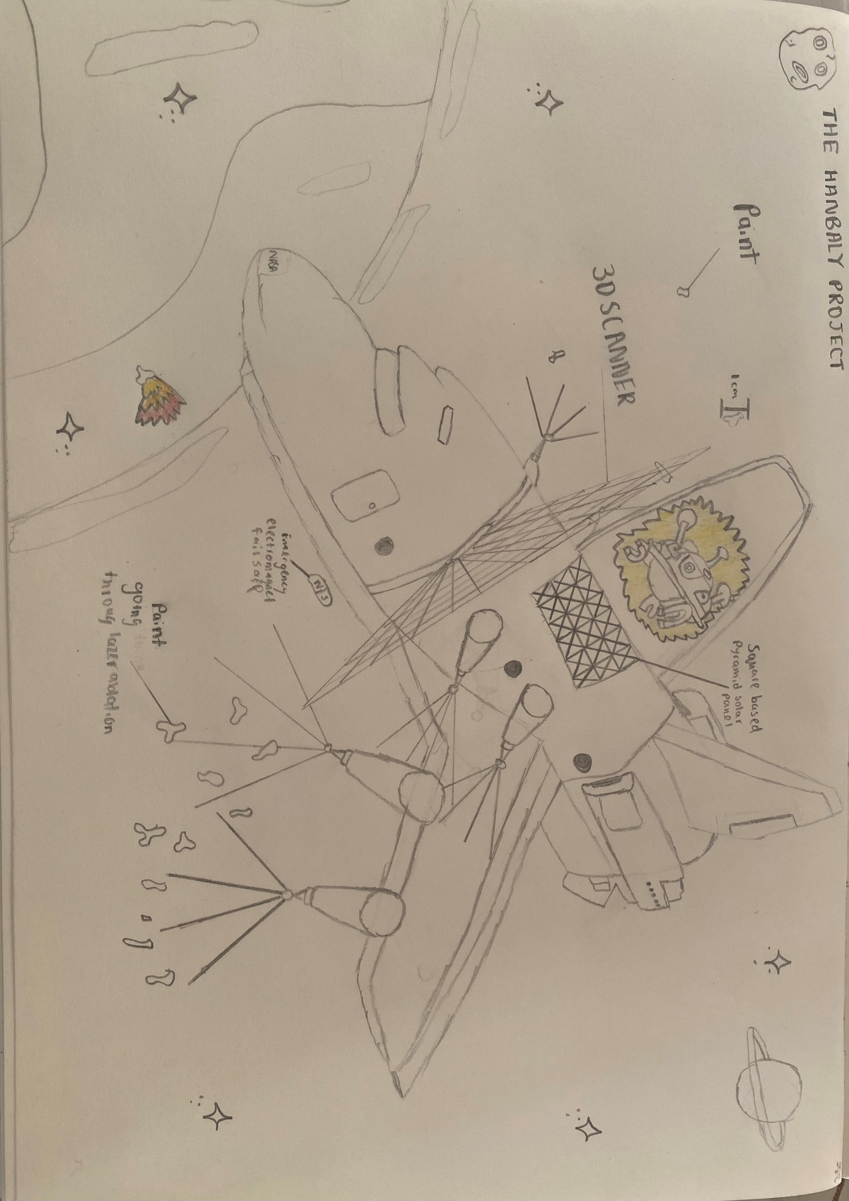
JIBREELS SKETCH ON THE HANBALY PROJECT

Slide 11
THE HAMBALY PROJECT

